Slide 1

Computer model, History and
the study of cultural evolution and long term economic dynamics
Simon Carrignon

Slide 2
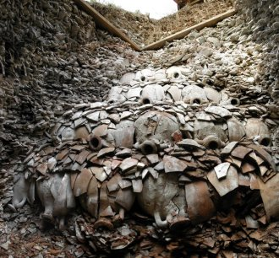
Let’s start from an applied case-study :
Monte Testaccio :
Amphora Garbage to understand trade and cultural interaction in the Ancient Rome

Slide 3
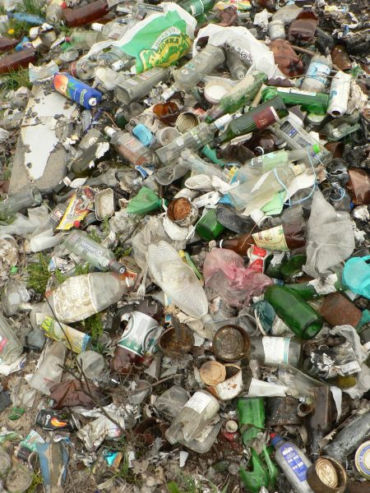

Slide 4
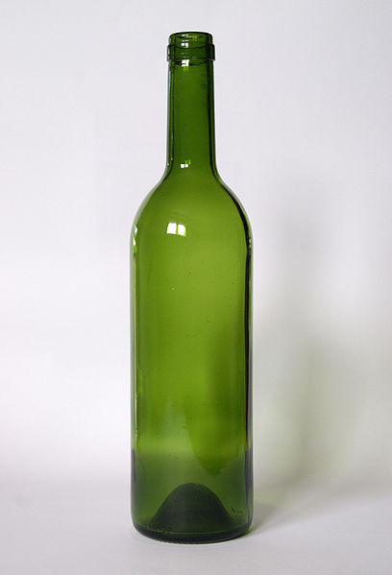
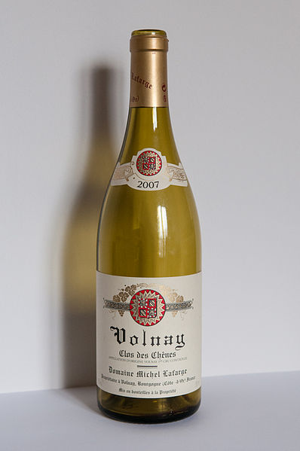
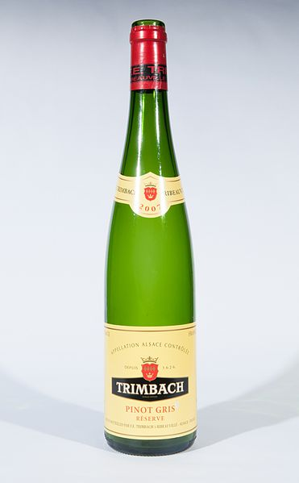

Slide 6
X 1
X 3
X 2

Slide 7
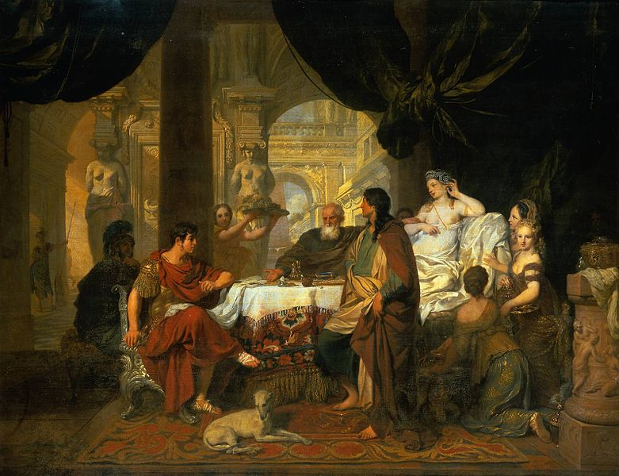

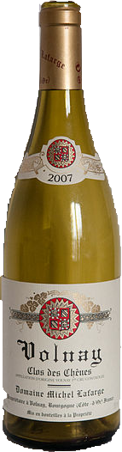
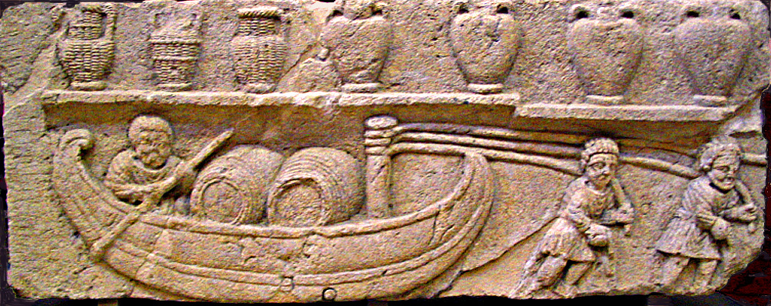
Historian Way
Social Mechanism
Economic Activity

Slide 8
Modelisation
Social Mechanisms
Economic Activity

Slide 9
Cultural Level
Modelisation
Imitation
Economic Level
Trade

Slide 10
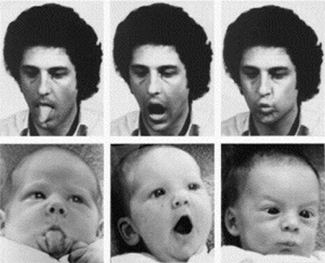
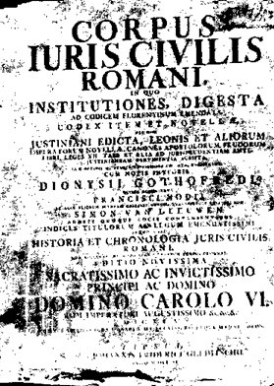
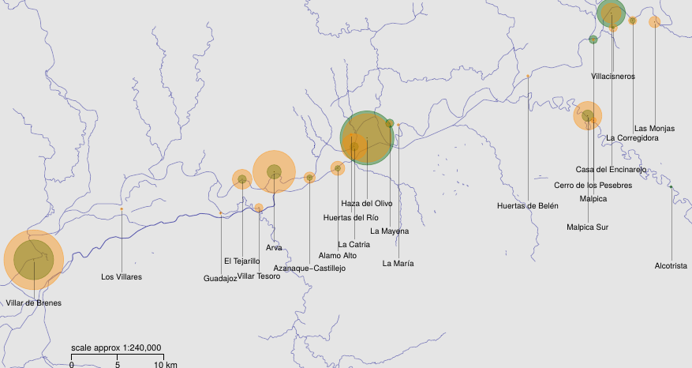
Assumption about the processes :
Imitation process,
Trade mechanisms,
Actors,
...

Slide 11
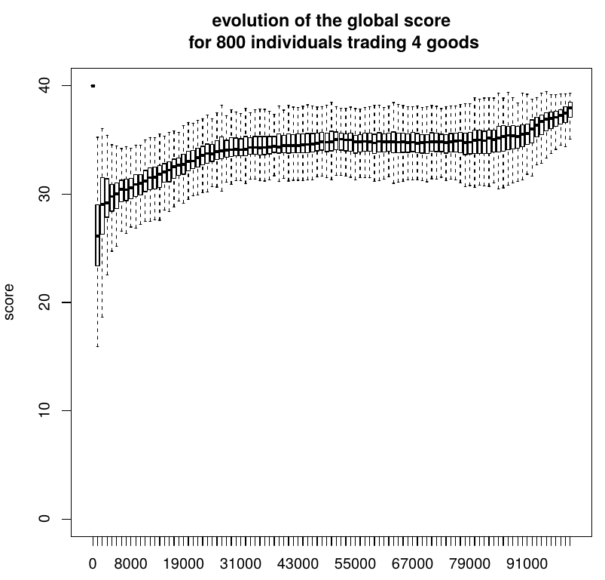
Model expectation :

Slide 12
Model expectation,
Vs real data :

Slide 13
Model expectation,
Vs real data :
WHY?

Slide 14
Generalisation
Cultural Level
Imitation
Economic Level
Trade

Slide 15
Generalisation
Cultural Level
Imitation
Economic Level
Trade

Slide 16
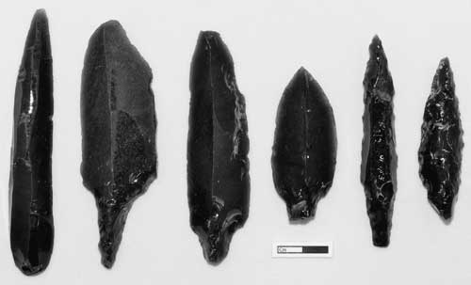
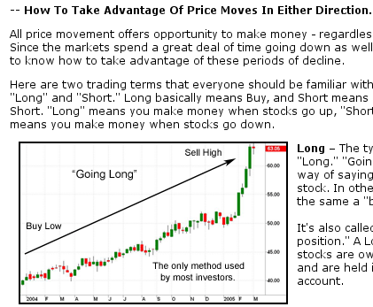
Generalisation
Cultural Level
Imitation
Economic Level
Trade

Slide 17
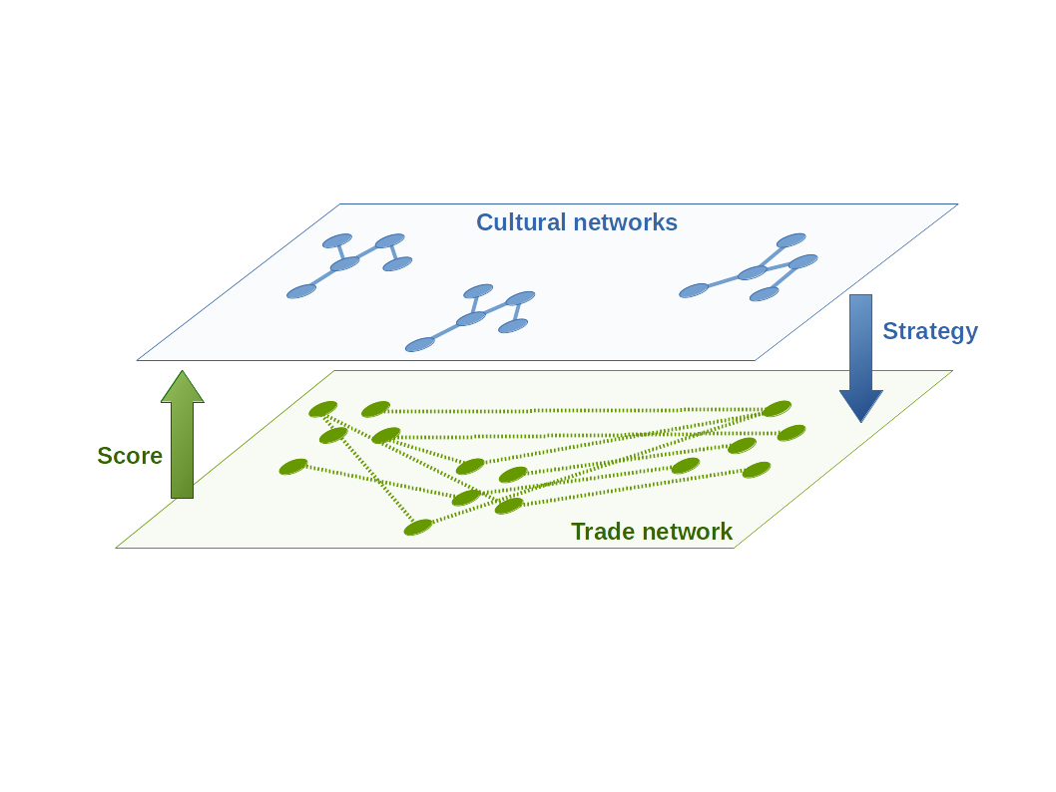
Theoretical Side

Slide 18
Theoretical Side
What properties lead to what kind of long term economic dynamics?
What impact on the Cultural Evolution?
….

Slide 19
Thank You!

